Slide 1

CRM Analyst Case Study
Utkarsh Som

Slide 2
Contents
RFM Model & Analysis
Banner Design for 'Bestselling Games' Newsletter
Newsletter Performance Analysis & Optimization Strategy

Slide 3
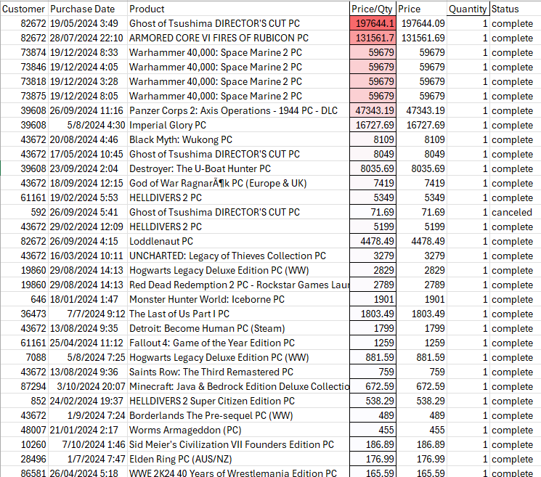
Case 1. RFM Model & Analysis
1. Data Preparation
Utilized a Python environment for model building and analysis.
Filtering Transactions: Retained only successful purchases (Status = ‘complete') to ensure accuracy in customer behavior analysis.
Handling Duplicates: Removed redundant records based on Customer, Product, Purchase Date, Price, Quantity, and Status to maintain data integrity.
Addressing Pricing Anomalies: Identified and corrected abnormally high Price/Quantity values by replacing them with the median price for the same product, ensuring consistency across transactions.
  Affected products included:
    Ghost of Tsushima DIRECTOR'S CUT PC
    Warhammer 40,000: Space Marine 2 PC
    ARMORED CORE VI FIRES OF RUBICON PC
    Panzer Corps 2: Axis Operations - 1944 PC - DLC
    Imperial Glory PC etc.
Standardizing Date-Time Formats: Ensured uniformity in date-time values for accurate Recency, Frequency, and Monetary (RFM) analysis.
Price Anomalies

Slide 4
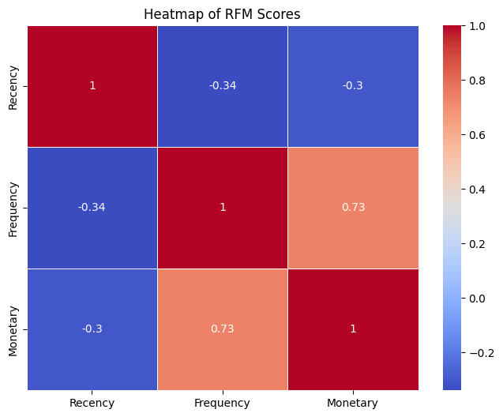
🔴 Red = strong positive correlation
🔵 Blue = strong negative correlation
Recency vs Frequency: -0.34
  Negative correlation (as recency increases, frequency tends to decrease — i.e., customers who purchased recently tend to buy more often).
Recency vs Monetary: -0.30
  Slight negative correlation (more recent customers tend to spend more).
Frequency vs Monetary: 0.73
  Strong positive correlation (customers who purchase more often tend to spend more).

Slide 5
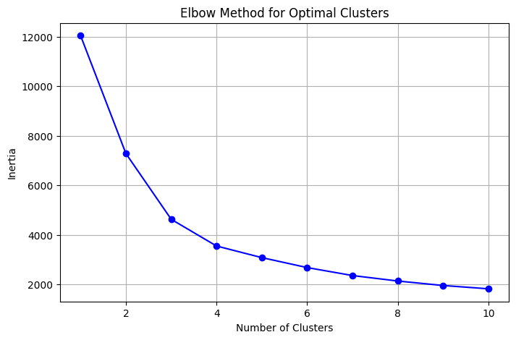
Case 1. RFM Model & Analysis
2. Defining the RFM Metrics
Setting Reference Date: Defined reference date as one day after the latest purchase date in the dataset.
Calculating Recency: Measured days since the last purchase for each customer.
Computing Frequency: Counted total purchases per customer to track engagement.
Calculating Monetary Value: Summed up total spend per customer (Price × Quantity).
Standardizing RFM Values: Applied Standard Scaling to normalize the dataset for clustering or further analysis.
Optimal Cluster Selection: Used the Elbow Method to determine the best number of clusters based on inertia.
K-Means Clustering: Applied K-Means (k=3) on the standardized RFM dataset. (why 3? Because 3 has the sharpest dip hence forming an Elbow)
The reason to opt for K-Means clustering is to have a more natural segmentation around the RFM metrics, rather than relying on rigid quartile-based segmentation.
3
Elbow Method for Optimal Clusters

Slide 6
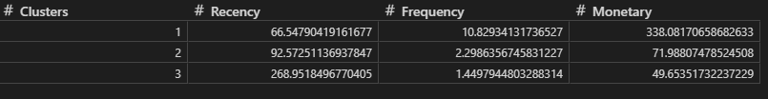
Case 1. RFM Model & Analysis
3. Customer Segmentation Using mean RFM metrics
Cluster 1
Low Recency
High Frequency
High Monetary
→ Likely Loyal Customers or High Value Customers
Cluster 2
Medium Recency
Moderate Frequency
Moderate Monetary
→ Likely Potential Loyalists or Regular Customers
Cluster 3
High Recency
Low Frequency
Low Monetary
→ Likely Lost Customers or At-Risk Customers

Slide 7
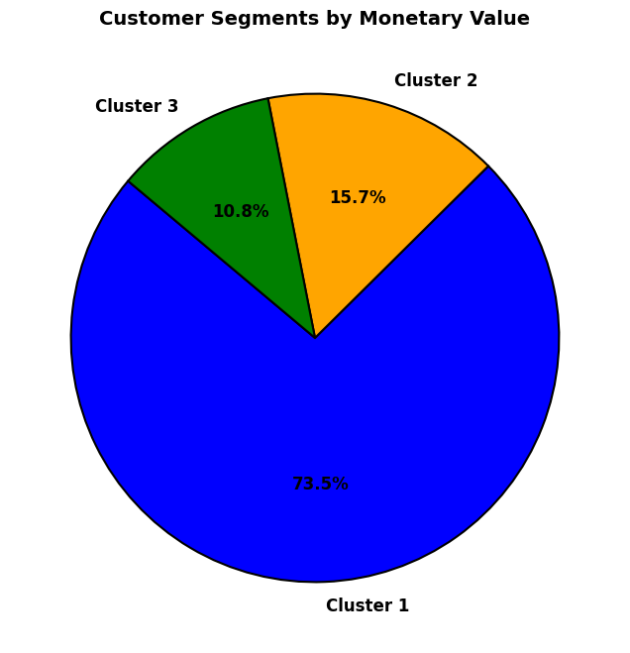
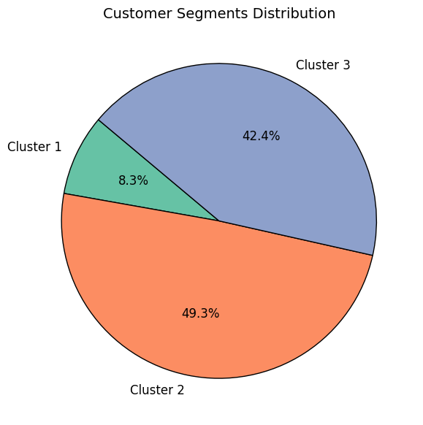
Case 1. RFM Model & Analysis
4. Customer Segmentation Analysis
Cluster | Share in Business | Share in Customer Base
1 | 73.5% | 8.3%
2 | 15.7% | 49.3%
3 | 10.8% | 42.4%
Here we can observe,
  Cluster 1 customers generates majority of the business revenue even though they are the smallest group.
  Cluster 2 is the largest customer segment, making up almost half of the customer base, but they contribute only a moderate portion to revenue.
  Cluster 3 segment is large but contributes very little to revenue.

Slide 8
Case 1. RFM Model & Analysis
Cluster | Cluster Label | Insights | Retention Strategies
Cluster 1 | High Value Customers | These are likely the most valuable customers, possibly frequent buyers or high spenders. Retaining and nurturing them is critical for profitability. | Strategy - Loyalty & VIP Treatment They generate most of the revenue. We should implement loyalty programs to retain them like exclusive perks (early access, premium support, VIP discounts).
Cluster 2 | Mid-Tier or Mass Customers | These could be regular buyers with lower spending power or moderate-frequency customers. | Strategy – Increase Frequency Low frequency shows they have potential but contribute less to revenue. We should try increasing their frequency. By implementing dynamic pricing and subscription models, bundled discounts
Cluster 3 | Low-Value or Dormant Customers | These could be infrequent or low-spending customers or dormant users. | Strategy – Win-Back We should engage them with targeted promotions, reminders, or personalized offers to boost spending.
5. Customer retention strategies

Slide 9
Case 1. RFM Model & Analysis
6. Conclusion
Concluding the RFM Model Analysis, our goal should be to convert Mid-Tier Customers (Cluster 2) to High Value Customers (Cluster 1), which can be done by offering Cluster 2 customer incentives that encourage higher Frequency and Monetary values.
Another objective should be to revive the Dormant Customers (Cluster 3), which can be achiever by Personalized Marketing and re-targeting this customer base.
  Few examples of Personalized Marketing can be,
    “We Miss You" promotions with personalized discounts.
    Mystery rewards (randomized discounts or free gifts).
    Run exit surveys to identify barriers & offer solutions.

Slide 10
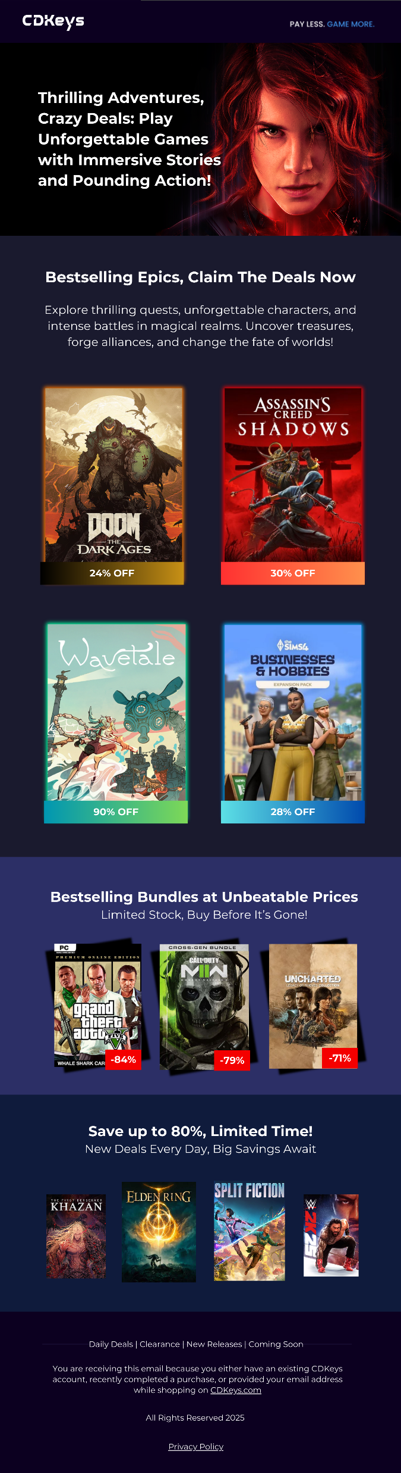
Case 2. Making 'Bestselling Games' Newsletter
1. Design choice and thought process
Complying with Company’s Branding Assets:
  I made sure to comply and resonate with the company’s branding guidelines and assets like font, colors and branding ideology.
Accurate Best-Selling & Deals from CDKeys:
  I have carefully selected the top-selling and best deal offers from the CDKeys website to ensure that the banner reflects real, up-to-date promotions.
Bold & Impactful Headline:
  I wanted the headline to immediately grab attention, so I used a bold, high-contrast font with phrases like "Thrilling Adventures, Crazy Deals" to create excitement. I kept the subtext short but powerful, emphasizing "Unforgettable Games" and "Pounding Action" to resonate with gamers.
Engaging Visuals:
  I made sure the hero image (red haired female - Jesse Faden from ‘Control’, one of my personal favourite game title) was intense and eye-catching, setting the tone for the banner. The game covers (Doom, Assassin’s Creed, etc.) highlight popular, bestselling titles, making the banner instantly recognizable to PC gamers.
Strong Call-to-Action & Urgency:
  I included phrases like "Claim the Deals Now" and "Limited Stock, Buy Before It’s Gone!" to push for immediate action. I also highlighted discounts (24%-90% OFF) in bright colors to make them impossible to miss.
Color Contrast & Readability:
  I went for a dark background to make the colors and text pop, ensuring easy readability. The use of white and bright accent colors made sure I catch attention without overwhelming the reader.

Slide 11
Case 2. Making 'Bestselling Games' Newsletter
2. How This Design Increases Engagement & Open Rates
First Impressions Matter: The banner is bold, clear, and visually exciting, ensuring that readers notice it right away.
FOMO: Highlighting time-limited discounts will encourages immediate action and clicks.
Scroll-Stopping Graphics: Using bestselling game covers increases familiarity and draws in gamers looking for deals.
Clear & Actionable Messaging: The banner gets straight to the point with minimum text and more focus on the gaming titles, making it effortless to scan and click-through without overwhelming the reader.
For High-Value Customers: I made sure to highlight premium bestselling games that appeal to loyal, high-spending gamers who are always looking for premium content.
For Mid-Tier or Mass Customers: To encourage higher-value purchases, I showcased discounted & bundle deals, giving them great value without breaking their budget.
For Low-Value or Dormant Customers: I included limited-time offers in the banner to create a sense of urgency and bring them back with irresistible deals.
3. Implementing RFM Analytics in the Newsletter

Slide 12
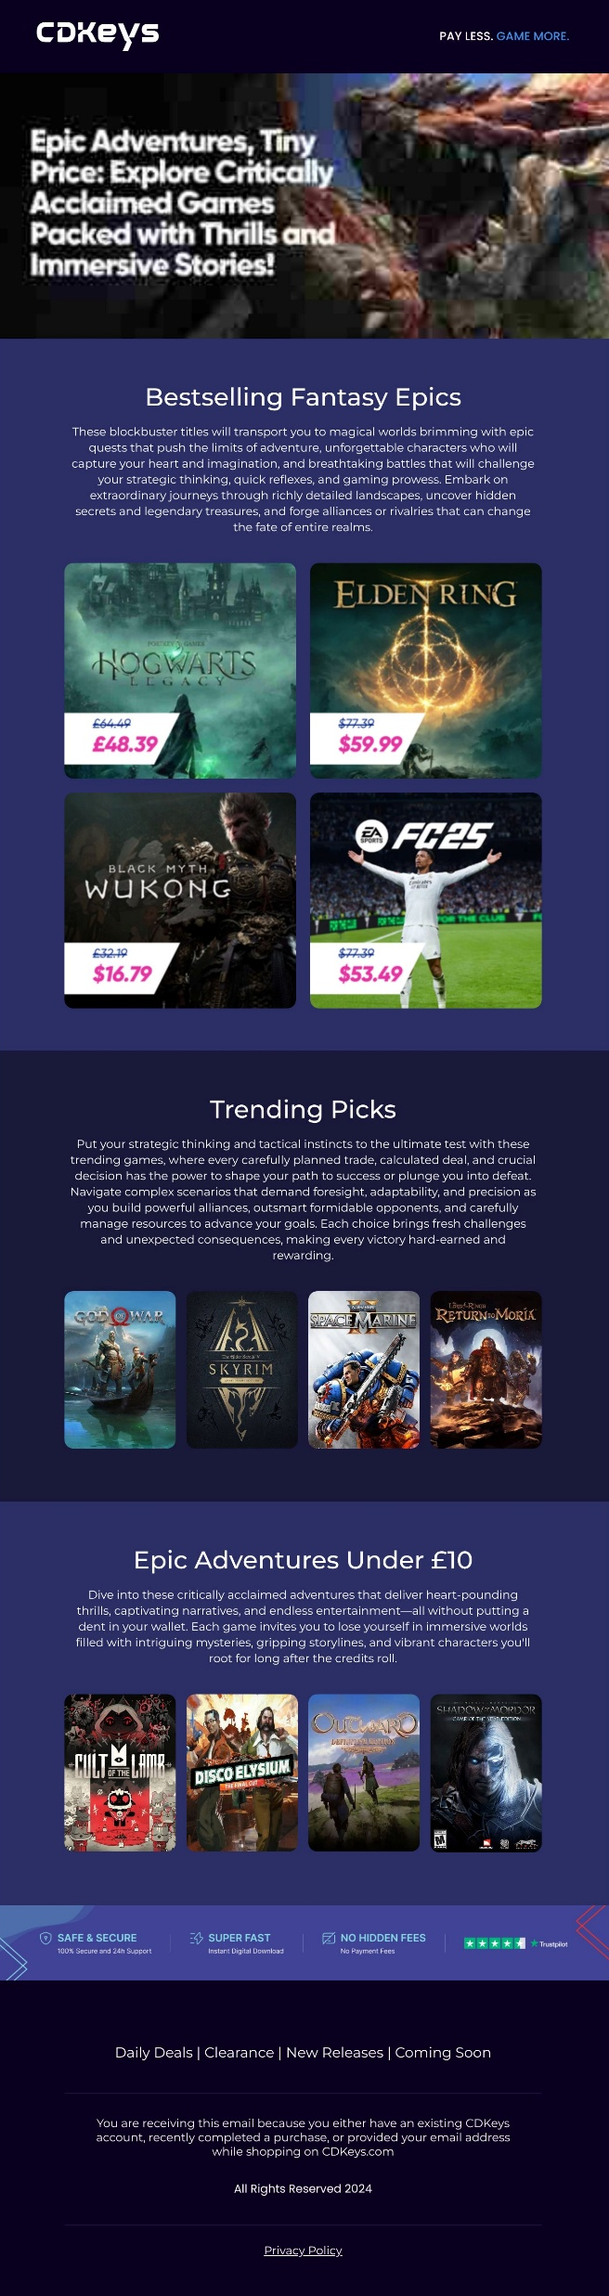
After going through the newsletter, I noticed a few gaps that, if fixed, could make a huge difference in engagement and conversions.
Case 3. Past Newsletter Analysis & Strategy
The Call-to-Action is Weak
  Problem: The newsletter gives great information but doesn’t really push people to act. If there’s no urgency, most readers will not convert.
  Solution: We need strong, attention-grabbers that make people want to click NOW.
    Something like: “Flash Sale, Ends at Midnight”
  Impact: These small tweaks can boost click-through rates.
Alot of Text with less focus on Games
  Problem: Too much text, I got confused and didn’t know where to look first.
  Solution: Simplifying the layout, will keep descriptions short and to the point.
  Impact: A cleaner layout makes it easier to read and helps the best deals stand out. More clarity = more conversions
No Urgency, No FOMO = No Rush to Buy
  Problem: There’s no real reason for readers to buy now instead of later, which often means never.
  Solution: To add elements that drive urgency, by mentioning Limited Stocks
  Impact: Creating urgency pushes people to act immediately instead of procrastinating.
The Subject Line needs to grab attention
  Problem: one of the reason for poor KPI performance could be the email subject line doesn’t grab attention, hence the emails weren’t opened.
  Solution: we will need to test subject lines through A/B Testing that create urgency and excitement:
  Impact: A strong subject line increases open rates, meaning more people actually see what’s inside.

